Slide 1
Lesson 5: Create A Blanket Agreement and A Blanket Purchase Order
Notes:
Notes:

Slide 2
Lesson 5 Learning Objectives
Upon completion of this Lesson, you should be able to:
  Find a “Requisition” that has been approved in your SRM’s Perform Sourcing. (Lesson 4)
  Understand the difference between a Blanket Agreement and a Blanket PO.
  Determine when and how to apply the appropriate clauses.
  Create a PO regardless of the Transaction Type with the appropriate clauses.
Notes:
Notes:

Slide 3
Blanket Agreement and Blanket PO
A Blanket Agreement should be used in accordance with Regulation 19-445.2100 of the SC Consolidated Procurement Code.
A Blanket PO should be used in accordance with the Policy for Use of Purchasing/Payment Document Types.
A Goods Receipt transaction (MIGO) is optional on Blanket POs.

Slide 4
Perform Sourcing to Create a
Blanket Agreement
uPerform Business Process Procedure (BPP) related to this function is available at http://uperform.sc.gov/gm/folder-1.11.3882.
SRM PUR Create a Blanket Agreement
Exercise 2: Create a Blanket Agreement
Helpful Hint: When in Doc Builder, the answer to the Dialog questions are “Yes,” “Yes” to create the “BLANKET PURCHASE AGREEMENT” clauses.
Notes:
Notes:

Slide 5
Perform Sourcing to Create a
Blanket PO
uPerform Business Process Procedure (BPP) related to this function is available at http://uperform.sc.gov/gm/folder-1.11.3882.
SRM PUR Create a Blanket Purchase Order
Exercise 3: Create a Blanket Purchase Order
Helpful Hint: When in Doc Builder, the answer to the Dialog questions are “Yes,” “No” to create the “STANDARD PURCHASE ORDER” clauses for other PO Transaction Types.
Notes:
Notes:

Slide 6
Lesson 5 Knowledge Check
Blanket PO Agreements should be used in accordance with Regulation 19-445.2100 of the SC Consolidated Procurement Code? (True/False)
Blanket POs should be used in accordance with the Policy for Use of Purchasing/Payment Document Types? (True/False)
Goods Receipt transactions (MIGO) are optional on Blanket POs? (True/False)
Notes:
Notes:
T
F
T

Slide 7
Lesson 5 Summary
You should be able to:
  Find a “Requisition” that has been approved in your SRM’s Perform Sourcing. (Lesson 4)
  Understand the difference between a Blanket Agreement and a Blanket PO.
  Determine when and how to apply the appropriate clauses.
  Create a PO, regardless of the Transaction Type, with the appropriate set of clauses.
Notes:
Notes:

Slide 8
Lesson 6: Create A Framework Purchase Order
Notes:
Notes:

Slide 9
Lesson 6 Learning Objectives
Upon completion of this lesson, you should be able to:
  Understand what makes a Framework PO different from Standard PO, Blanket PO, and Inventory PO.
  Understand the Framework PO process.
  Understand where to find the Framework uPerform, SRM PUR Create a Framework Purchase Order
Notes:
Notes:

Slide 10
Framework PO
A Framework PO:
  Process begins with the Buyer creating a “Limit Item” Shopping Cart and then creating a Framework PO.
    Purchasing →Purchasing →Create Documents →Shopping Cart→ Add Item → Limit Item
  Is not created through the normal SRM Shopping Cart approval and workflow process.
  Requires a Product Category (5 digit / NIGP code), value limit, a required date, and a supplier number.
  Does not encumber funds.

Slide 11
Framework PO
A Framework PO:
  Does not create an actual Line Item in ECC. The Line Item in ECC is a virtual Line Item.
  Does not generate any data on the ECC’s “Delivery” tab, as a results the “Delivery Complete” checkbox is not even present in ECC.
  The Line Item you see in ECC is an aggregate, a composite of tables from the SCEIS “back-end” system.
  Cannot process a Goods Receipt because of the lack of a real Line Item. The virtual Line Item prevents any Confirmation/Goods Receipt.

Slide 12
Framework PO
A Framework PO:
  Cannot be linked to a contract because of the virtual Line Item.

Slide 13
Create a Framework PO
uPerform Business Process Procedure (BPP) related to this function is available at http://uperform.sc.gov/gm/folder-1.11.3882.
SRM PUR Create a Framework Purchase Order
Notes:
Notes:

Slide 14
Lesson 6 Knowledge Check
Framework POs are created from a Limit Item Shopping Cart? (True/False)
A Goods Receipt transaction (MIGO) is mandatory on a Framework PO? (True/False)
A Framework PO can be linked to a contract? (True/False)
Notes:
Notes:
T
F
T

Slide 15
Lesson 6 Summary
You should now understand:
  What makes a Framework PO different from Standard PO, Blanket PO, and Inventory PO.
  Understand the Framework PO process.
  Understand where to find the Framework uPerform, SRM PUR Create a Framework Purchase Order
Notes:
Notes:

Slide 16
Lesson 7: ADDITIONS to A Purchase Order
Notes:
Notes:

Slide 17
Lesson 7 Learning Objectives
Upon completion of this lesson, you should be able to:
  Understand the following additions to a PO:
    Add Small Purchase Order Terms and Conditions from Document Builder
    Add Vendor Text: Header and Line Item
    Add Internal Note: Header and Line Item
    Add an Attachment(s)
    Add Conditions
      Freight
      Trade-in
Notes:
This icon will indicate when each participant will need to learn and practice transactions in the SAP Sandbox.

Slide 18
Additions to a PO
uPerform Business Process Procedures (BPPs) related to this function are available at http://uperform.sc.gov/gm/folder-1.11.3882.
SRM PUR Add Small Purchase Order Terms and Conditions
SRM PUR Add Vendor Text at Line Item
SRM PUR Add Vendor Text at Header
SRM PUR Add Internal Note at Line Item
SRM PUR Add Internal Note at Header
SRM PUR Add Attachment
SRM PUR Add Conditions to Purchase Order
Notes:
Notes:

Slide 19
Lesson 7 Summary
You should now be able to add the following to a PO:
  Small Purchase Order Terms and Conditions from Document Builder
  Vendor Text: Header and Line Item
  Internal Note: Header and Line Item
  Attachments
  Conditions
    Freight
    Trade-in
Notes:
Notes:

Slide 20
Lesson 7 Knowledge Check
The file name of an Attachment can be no greater than 30 characters? (True/False)
After adding Conditions to a PO you must SAVE the document, then click EDIT, and then ORDER the document? (True/False)
NIGP Code/Product Category, 96286, Miscellaneous Services: Transportation of Goods and Other Freight Services is a suitable NIGP Code/Product Category to use if Freight is created as a Line Item on a PO? (True/False)
Notes:
Notes:
T
F
T

Slide 21
Lesson 8: Edit a Purchase Order
Notes:
Notes:

Slide 22
Lesson 8 Learning Objectives
Upon completion of this lesson, you should understand how to edit the following fields in a PO:
  Add a Contract Number.
  Add an Asset.
  Add Split Fund Asset.
  Change NIGP Code Prior to Order.
  Change Vendor Prior to Order.
  Delete Purchase Order at Header.
  Delete Purchase Order at Line Item.
Notes:
This icon will indicate when each participant will need to learn and practice transactions in the SAP Sandbox.

Slide 23
Edit a Purchase Order
uPerform Business Process Procedures (BPPs) related to this function are available at http://uperform.sc.gov/gm/folder-1.11.3882.
SRM PUR Add Contract Number to Purchase Order
Prior to Order
SRM PUR Add Asset in Purchase Order
SRM PUR Add Split Fund Asset
SRM PUR Change NIGP Code in Purchase Order Prior to Order
SRM PUR Change Supplier in Purchase Order
Prior to Order
SRM PUR Delete Purchase Order at Header
SRM PUR Delete Purchase Order at Line Item
Notes:
Notes:

Slide 24
Lesson 8 Summary
You should now be able to edit a PO with the following:
  Add a Contract Number.
  Add an Asset.
  Add Split Fund Asset.
  Change NIGP Code Prior to Order.
  Change a Vendor Prior to Order.
  Delete Purchase Order at Header.
  Delete Purchase Order at Line Item.
Notes:
Notes:

Slide 25
Lesson 9: MANAGE No FURTHER CONFIRMATION, No further invoice & LoCK
Notes:
Notes:

Slide 26
Lesson 9 Learning Objectives
Upon completion of this lesson, you should understand how to manage a line item for No Further Confirmation, No Further Invoice and Lock, and the effect to ECC.
  Process a line item for No Further Confirmation, No Further Invoice and/or Lock.
  Use the ME23N folder to verify that the transaction produced the desired results.
  Use the Commitment & Funds Display folder to review any encumbrance.
  Determine if a line item has been marked No Further Confirmation, No Further Invoice and/or Locked.
Notes:
This icon will indicate when each participant will need to learn and practice transactions in the SAP Sandbox.

Slide 27
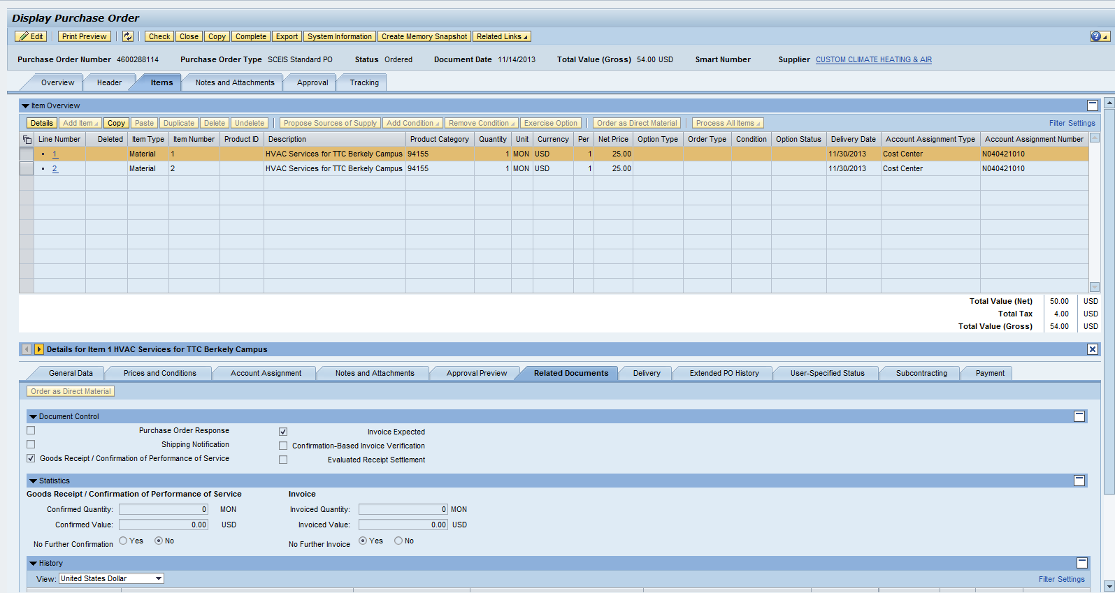
Manage No Further Confirmation and No Further Invoice
These two procedures can be found by clicking the Items tab then clicking the Related Documents tab.

Slide 28
Manage No Further Confirmation and No Further Invoice
No Further Confirmation (NFC):
  This means that no additional Goods Receipts are expected for the line item. Although a further delivery is not expected, it is still possible. NFC does not lock the line item.
  No Further Invoice (NFI):
  Selecting the NFI button in SRM will only unencumber the funds and set the “Final Invoice” indicator in ECC. NFI does not lock the line item.
Notes:
This icon will indicate when each participant will need to learn and practice transactions in the SAP Sandbox.

Slide 29
Manage No Further Confirmation and No Further Invoice
  The No radio button is the default for both No Further Confirmation and No Further Invoice. This means that the transactions are not active.
  To activate either No Further Confirmation or No Further Invoice, click the Yes radio button.
  There will be a yellow message to indicate that the PO has an item or items that have been marked No Further Confirmation or No Further Invoice:
Notes:
This icon will indicate when each participant will need to learn and practice transactions in the SAP Sandbox.

Slide 30
Verify No Further Confirmation and No Further Invoice
No Further Confirmation
To verify that the line has been marked No Further Confirmation or No Further Invoice, use the ME23N folder.
This procedure will activate the ECC
Delivery Complete indicator in the line item indicating in the system that No Further Confirmations are expected.

Slide 31
Verify No Further Confirmation and No Further Invoice
No Further Invoice
To verify the No Further Invoice has reduced the PO Encumbrance use the Commitment & Funds Display folder.
This procedure will activate the ECC Final Invoice Indicator, which will unencumber funds.

Slide 32
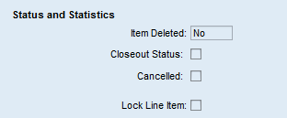
Lock a PO Line Item
The “Lock Line Item” status is accessible in the PO under the “General Data” tab by clicking on the “Items” tab, then the “Details” button.
When a PO line item has been locked users will see the following warning message:

Slide 33
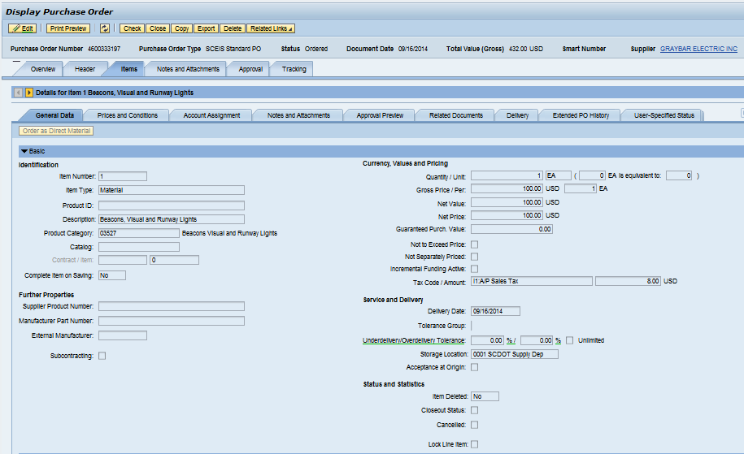
Lock a PO Line Item

Slide 34
Lock a PO Line Item
Only when a buyer checks the “Lock Line Item” checkbox will the system prevent no further goods receipts and no further invoice payments in ECC on the line item selected.
The lock will allow changes to be made to the PO in SRM, but these changes will not transfer to ECC until the “Lock Line Item” has been unselected.

Slide 35
Manage No Further Confirmation,
No Further Invoice and Lock
The following Business Process Procedures detailing the changes were made available on August
29, 2014 on the SCEIS uPerform site at http://uperform.sc.gov/gm/folder-1.11.3882 :
SRM PUR Line Item Lock on Purchase Order
SRM PUR No Further Invoice on Purchase Order
SRM PUR Display Locked Purchase Order
Line Item
Notes:
Notes:

Slide 36
Manage No Further Confirmation,
No Further Invoice and Lock
Prior to this modification, if a user selected either “No Further Confirmation” or “No Further Invoice” to a line item of a PO, the system placed a “Lock” icon on the ECC PO line item.
This action may have been premature if the invoice had not yet been keyed. This premature action could then cause the Accounts Payable staff to contact the buyer to have the PO line item “unlocked.”
This modification will make the system more efficient and eliminate the need for the buyer to unlock the line item.

Slide 37
Lesson 9 Summary
You should now be able to edit a PO with the following:
  Manage No Further Confirmation, No Further Invoice and Lock
  Use the ME23N folder to verify that the transaction produced the desired results
  Use Commitment & Funds Display folder to review encumbrance
  Determine if a line or lines in a PO have been marked No Further Confirmation, No Further Invoice and/or Locked
Notes:
Notes:

Slide 38
Lesson 10: Create a Standard Purchase Order with Retention
Notes:
Notes:

Slide 39
Lesson 10 Learning Objectives
Upon completion of this lesson, you should be able to:
  Understand and create Retention at the Header Level.
  Understand and create Retention at the Line Item Level.
Notes:
Notes:

Slide 40
Demo
uPerform Business Process Procedures (BPPs) related to this function are available at http://uperform.sc.gov/gm/folder-1.11.3882.
SRM PUR Create Purchase Order with Retention at Header Level
SRM PUR Create Purchase Order with Retention
at Item Level
Notes:
Notes:

Slide 41
Lesson 10 Summary
You should now be able to:
  Create a PO with Retention at the Header Level.
  Create a PO with Retention at the Line Item Level.
Notes:
Notes:

Slide 42
Lesson 11: Create an Inventory Purchase Order
Notes:
Notes:

Slide 43
Lesson 11 Learning Objectives
Upon completion of this lesson, you should understand:
  The process flow of an Inventory Purchase Requisition to an Inventory PO.
  How to display PO tracking.
Notes:
Notes:

Slide 44

Replenishment of Inventory –
Process Flow
No change for the Inventory Staff
  The Material Requirements Planning Controller (MRP Controller) will initiate the Purchase Requisition (PR) and the system converts the PR into a Shopping Cart.
  No change for the Buyer
  Once a Shopping Cart is in SRM you will follow the process to Find/Display a Shopping Cart and Create a Purchase Order. The Transaction Type will still be Inventory PO, ZINV.

Slide 45
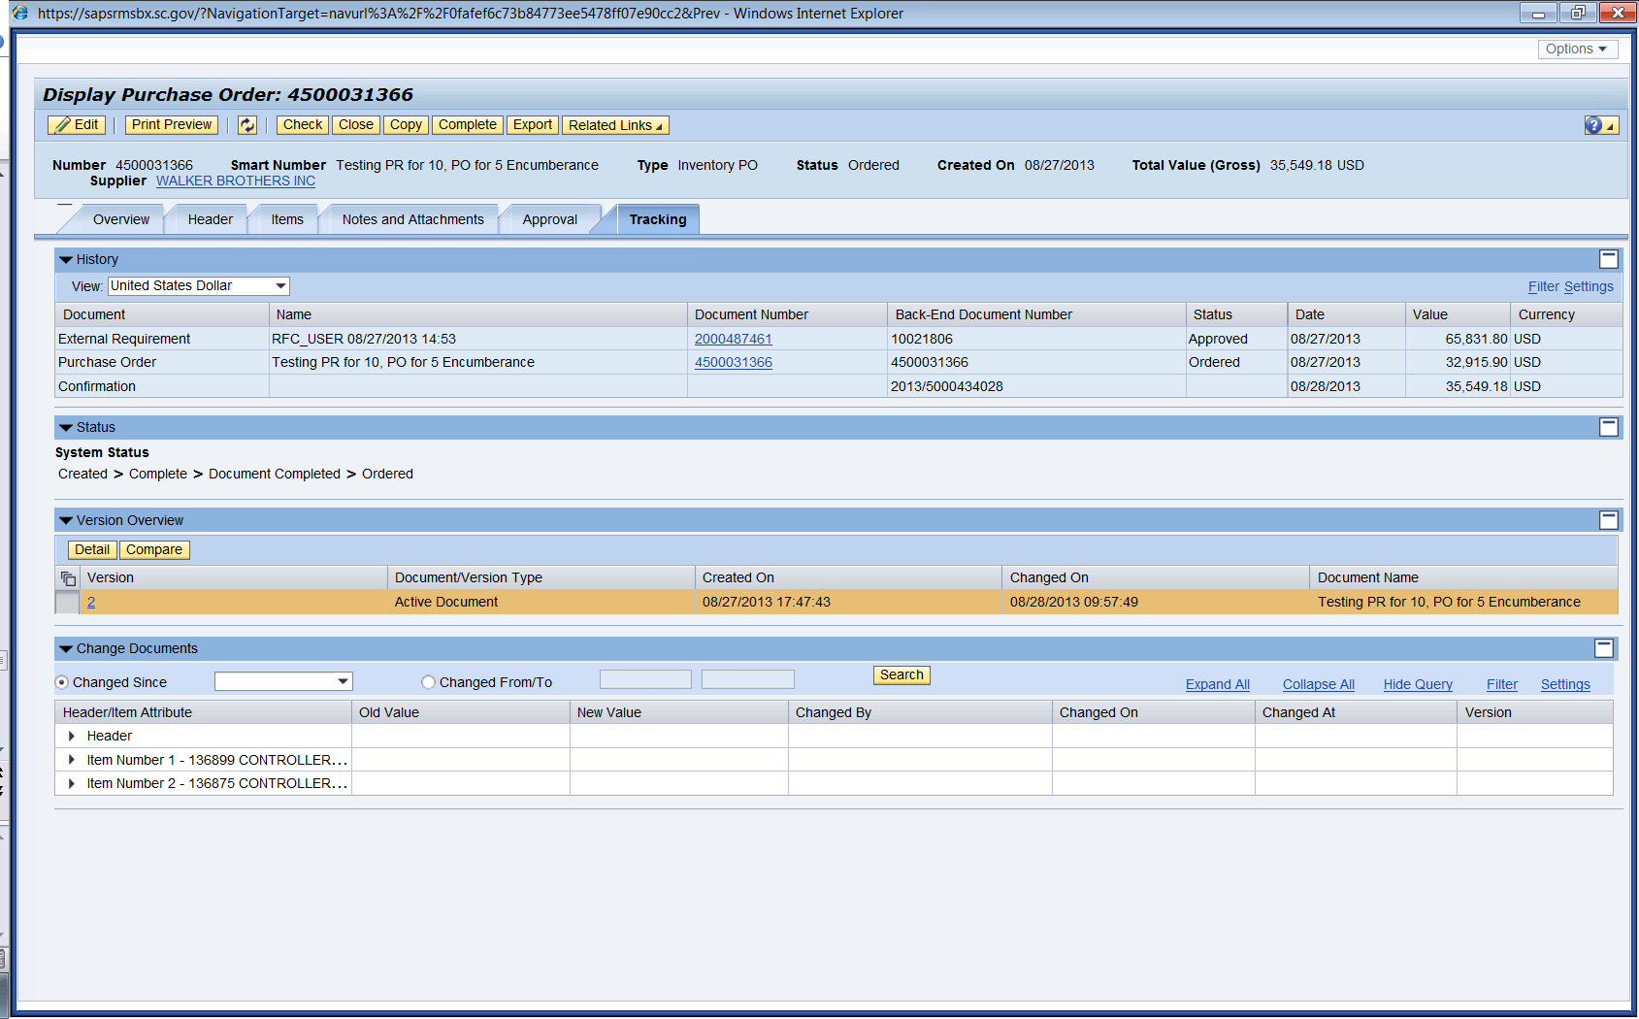
PO Tracking
In the Tracking tab, you can see that the “Back-End Document Number” column reflects the Purchase Requisition number created in ECC (10021806), which is then converted into a Shopping Cart Number, 2000487461.
Notes:
Notes:

Slide 46
Lesson 11 Summary
You should now understand:
  The process flow of an Inventory Purchase Requisition to an Inventory PO.
  How to display PO tracking.
Notes:
Notes:

Slide 47
COURSE SUMMARY
Notes:
Notes:

Slide 48
Course Summary
You should now be able to:
  Navigate in Supplier Relationship Management (SRM) 7.2 and understand key terms and concepts.
  Understand the SCEIS SRM 7.2 purchasing process.
  Understand Transaction Types and Document Numbers in SRM.
  Redistribute Workload.
  Create various Purchase Order Transaction Types with the appropriate clauses.
Notes:
Notes:

Slide 49
Course Summary cont.
You should now be able to:
  Make Additions to and edit a Purchase Order.
  Print a Purchase Order.
  Understand Extended Purchase Order History.
  Create a Standard Purchase Order with Retention at the Header Level and Line Item Level.
Notes:
Notes:

Slide 50
Course Knowledge Check
Complete the following statement:
  Additional Text can be added to the Purchase Order?
    a. At the Line Item Level
    b. At the Header Level
    c. Both (a) and (b)
Notes:
Notes:
C.

Slide 51
Course Knowledge Check cont.
How do you determine whether a Goods Receipt has occurred against a Purchase Order?
  Email your agency’s finance department with “Return Receipt Requested” and wait for a response.
  b. Call the end user and ask them if they have the packing list.
  c. Look under the Tracking tab on the Purchase Order.
Notes:
Notes:
C

Slide 52
Course Knowledge Check cont.
Which of the following is correct for vehicle purchases? (A/B)
  A. Tax needs to be created as a separate Line Item on the Purchase Order for $300.00.
  B. Tax needs to be indicated on the Line Item as taxable by selecting Tax Code/Amount “I1 – A/P Sales Tax” under “Items” and “General Data” tabs.
Notes:
Notes:
A.

Slide 53
Course Knowledge Check cont.
Which of the following is correct when adding freight charges to the Purchase Order? (A/B)
  Add freight as a “Condition” in the Purchase Order “Prices and Conditions” tab.
  Select NIGP Code/Product Category, 96286 (Miscellaneous Services: Transportation of Goods and Other Freight Services) as a suitable NIGP Code/Product Category to use if Freight is created as a Line Item on a Purchase Order.
Notes:
Notes:
B.

Slide 54
Course Knowledge Check cont.
Complete the following statement:
  It is a good idea to process the Open Encumbrance Report monthly because:
  a. This will give you an idea of POs that may need to be expedited, deleted, or marked “No Further Confirmation” and “No Further Invoice.”
  b. You may have Goods Receipts that have not been invoiced causing late payments to the vendors.
  c. You can see the POs that need your attention regarding coordination with the ultimate user, the Supplier and PO Process Management (For example: processing Good Receipts, No Further Confirmations, No Further Invoicing or deleting).
  d. All of the above.
Notes:
Notes:
A.

Slide 55

Any Questions?
Notes:
Notes:

Slide 56
Next Steps
Go to the SCEIS uPerform website at http://uperform.sc.gov.
  Click Business Process Procedures (BPPs) then Supplier Relationship Management (SRM) to view step-by-step instructions and examples related to this course.
  Or, click Courses to view the Participant Guide and other handouts related to this course.
View the CG Policy on the Use of Purchase Orders and Direct Expenditures at http://www.cg.sc.gov.
View MMO’s Procurement Services at http://procurement.sc.gov/PS/PS-index.phtm.
Notes:
Notes:

Slide 57
Evaluation
Please complete the online course evaluation in Blackboard.
Your input will help to shape future enhancements to the
SCEIS End User Training Program
Go to the SCEIS website http://www.sceis.sc.gov click on Training and then click Blackboard
Notes:
Notes:

